Slide 1
Semantic Networks

Slide 2
Fundamentals
Semantic Networks
Generate and Test
Production Systems
Means-Ends Analysis
Problem Reduction

Slide 3
Lesson Preview
Knowledge representations
Semantic networks
Problem-solving with semantic networks
Represent & Reason

Slide 4
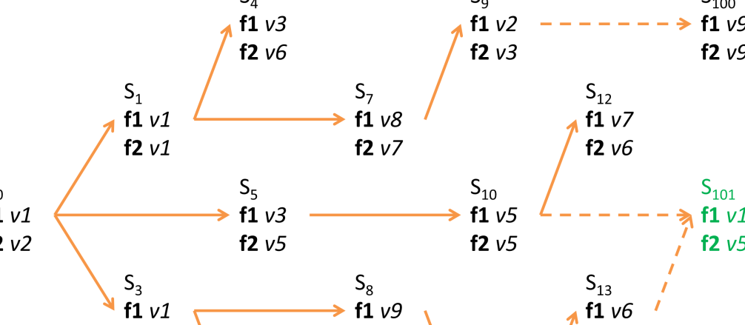
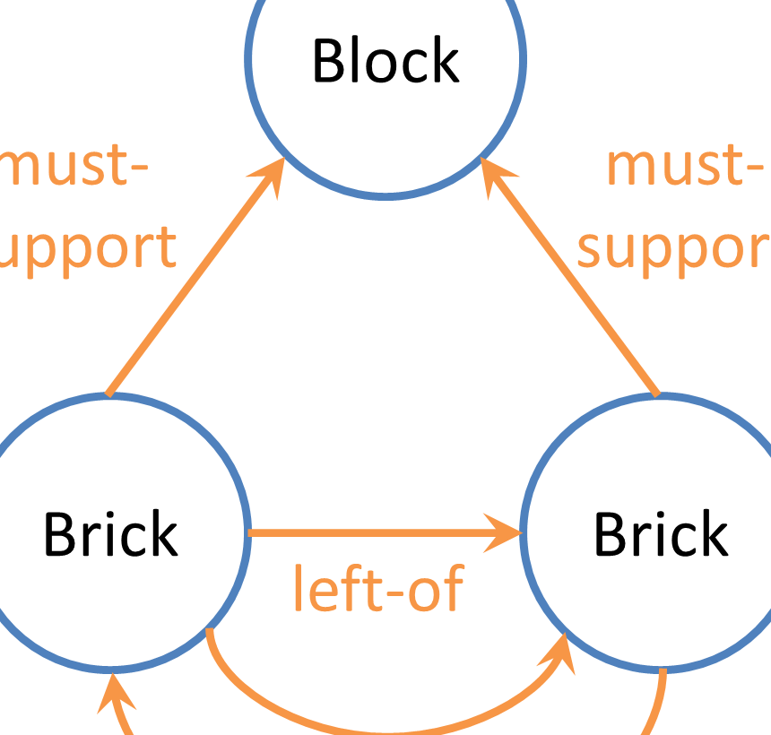
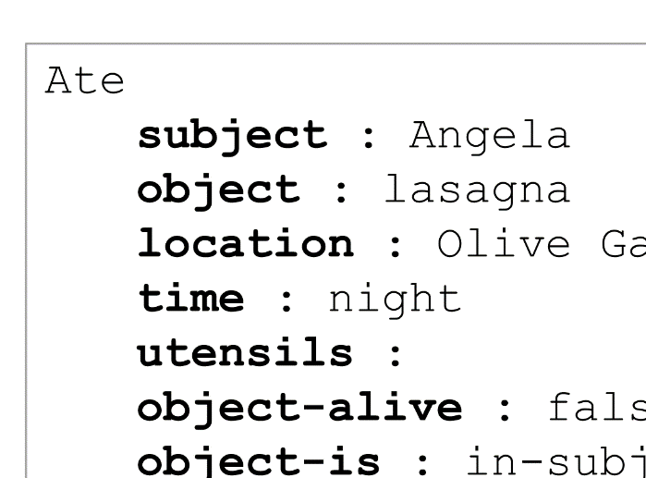
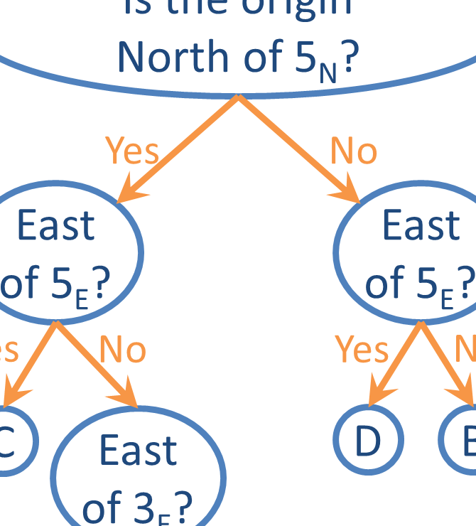
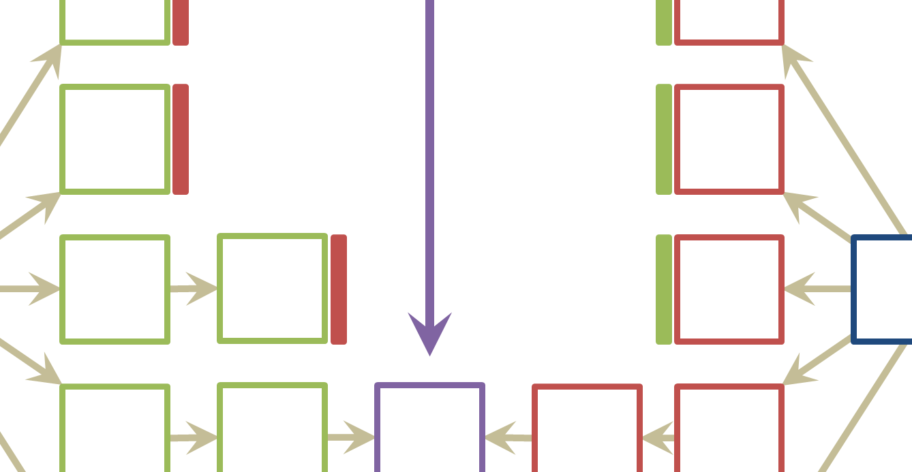

Slide 5
A
B
C
#
?
1
2
3
4
5
6

Slide 6
A
B
z
y
x
y
x
x
unchanged
x
inside
above
above
y
expanded
y
above
z
deleted
z

Slide 7
u
v
v
v
unchanged
v
inside
u
deleted
u

Slide 8
The relationships between the pieces and the transformations between the frames.
A
B
C
5
z
y
t
s
x
y
x
s
r
r
x
unchanged
x
r
unchanged
r
inside
above
inside
above
above
y
expanded
y
above
s
unchanged
s
above
above
z
deleted
z
t
deleted
t

Slide 9
Structure of Semantic Networks
Lexically: nodes
Structurally: directional links
Semantically: application-specific labels
x
unchanged
x
inside
above
above
y
expanded
y
above
z
deleted
z

Slide 10
Characteristics of Good Representations
Make relationships explicit
Expose natural constraints
Bring objects and relations together
Exclude extraneous details
Transparent, concise, complete, fast, computable

Slide 11
Guards & Prisoners Problem
Also known by other names (cannibals and missionaries, jealous husbands, brothers and sisters).
Originally appeared in the 1200-year-old text Propositiones ad Acuendos Juvenes.
Used by throughout AI for problem representation.

Slide 12
Guards & Prisoners Problem
Three guards and three prisoners must cross river.
Boat may take only one or two people at a time.
Prisoners may never outnumber guards on either coast, though prisoners may be alone on either coast).

Slide 13









⛵
⛵

Slide 14




⛵





⛵









⛵
⛵




⛵




⛵

Slide 15




⛵





⛵









⛵
⛵




⛵




⛵

Slide 16





⛵




⛵




⛵

Slide 17





⛵








⛵
⛵





⛵

Slide 18









⛵
⛵











⛵
⛵
⛵










⛵
⛵

Slide 19









⛵
⛵











⛵
⛵
⛵










⛵
⛵

Slide 20





⛵











⛵
⛵
⛵





⛵

Slide 21
Exercise: How many moves does it take to move everyone to the other side?
11






















⛵
⛵
⛵
⛵
⛵





















⛵
⛵
⛵
⛵
⛵







⛵
⛵

Slide 22
A
B
C
5
z
t
y
s
x
y
x
s
r
r
x
unchanged
x
r
unchanged
r
inside
above
inside
above
above
y
expanded
y
above
s
unchanged
s
above
above
z
deleted
z
t
deleted
t

Slide 23
A
B
C
5
z
t
y
s
x
y
x
s
r
r
x
unchanged
x
r
unchanged
r
inside
above
inside
above
above
y
expanded
y
above
s
unchanged
s
above
above
z
deleted
z
t
deleted
t

Slide 24
A
B
C
2
z
t
y
s
x
y
x
s
r
r
x
unchanged
x
r
unchanged
r
inside
above
inside
above
above
y
expanded
y
above
s
expanded
s
above
above
z
deleted
z
t
deleted
t
Is this the right answer to the problem? ο Yes ο No

Slide 25
A
B
C
2
z
t
y
s
x
y
x
s
r
r
x
unchanged
x
r
unchanged
r
inside
above
inside
above
above
y
expanded
y
above
s
expanded
s
above
above
z
deleted
z
t
deleted
t
Is this the right answer to the problem? ο Yes ο No

Slide 26
A
B
C
#
?
1
2
3
4
5
6
ο
ο
ο
ο
ο
ο

Slide 27
A
B
C
#
?
1
2
3
4
5
6
ο
ο
ο
ο
ο
ο

Slide 28
Transformation #1
Similarity Weights
Transformation #2
A
B
5 points | Unchanged
4 points | Reflected
3 points | Rotated
2 points | Scaled
1 points | Deleted
0 points | Shape Changed
A
B
p
q
p
p
q
q
p
deleted
+1
p
p
expanded
+2
p
inside
inside
q
unchanged
+5
q
q
deleted
+1
q
Similarity:
6 points
Similarity:
3 points

Slide 29
A
B
C
#
?
1
2
3
4
5
6
ο
ο
ο
ο
ο
ο

Slide 30
Similarity Weights
A
B
C
#
5 points | Unchanged
4 points | Reflected
3 points | Rotated
2 points | Scaled
1 points | Deleted
0 points | Shape Changed
?
1
2
3
4

Slide 31
Assignment
How would you use semantic networks to design an agent that can answer Raven’s Progressive Matrices?

Slide 32
To recap…
Representations
Semantic networks
Represent & Reason
Weights with Represent & Reason

Slide 33
What is the answer to this problem?
A
B
C
#
?
1
2
3
4
5
6
ο
ο
ο
ο
ο
ο

Slide 34
What is the answer to this problem?
A
B
C
#
?
1
2
3
4
5
6
ο
ο
ο
ο
ο
ο

Slide 35
Horizontal Reflection
180° Rotation
A
B
A
B
q
q
q
q
q
reflected
q
q
rotated
q
cost: 1
cost: 2

Slide 36
Horizontal Reflection
180° Rotation
C
2
C
6
q
q
q
q
q
reflected
q
q
rotated
q
cost: 1
cost: 2
What would the answer be? ο 2 ο 6

Slide 37
A
B
C
#
?
1
2
3
4
5
6
ο
ο
ο
ο
ο
ο

Slide 38
A
B
C
#
?
1
2
3
4
5
6
ο
ο
ο
ο
ο
ο

